Slide 1


University of Basrah
Al-Zahraa Medical College
Ministry of higher Education and Scientific Research
Academic year 2021-2022
5th year
REPRODUCTIVE BLOCK
Lecture 1
Duration : 1 hour
Antepartum haemorrage
Presented by
Dr.RAYA MUSLIM AL HASSAN
Block staff:
Dr.Raya Muslim Al Hassan (Block leader)
Dr.Marwa Sadik (coleader)
Dr. Abdul kareem Hussain Subber
Dr.Alaa Hufdhi
GYNAECOLOGY 20th
EDITION by Ten Teachers

Slide 2
Learning objectives
University of Basrah
Al-Zahraa Medical College
Ministry of higher Education and Scientific Research
To understand ,The definition ,causes ,pathophysiology & management Of APH .
To Know the management of hypovolaemic shock in Obstetrics .
To gain the experience if you received patient with APH and
how you can reach the diagnosis from history, examination & investigation .
& then how you manage according to the cause .

Slide 3
University of Basrah
Al-Zahraa Medical College
Ministry of higher Education and Scientific Research
Vaginal bleeding from 24 weeks to delivery of the baby is defined as an antepartum haemorrhage (APH).
At term APH can be difficult to distinguish from show which is the release of the cervical mucous in the early stages of labour .
Incidance:3%
Causes of antepartum haemorrhage
Placental causes Placental abruption. Placenta praevia.
Fetal cause: Vasa praevia.
maternal Local causes:
- Cervicitis.
- Cervical ectropion. Cervical carcinoma.
- Vaginal trauma. Vaginal infection.

Slide 4
University of Basrah
Al-Zahraa Medical College
Ministry of higher Education and Scientific Research
Placental abruption
Placental abruption is the premature separation of the placenta from the uterine wall. The bleeding is maternal and/or fetal and abruption is acutely dangerous for both the mother and fetus .

Slide 5
University of Basrah
Al-Zahraa Medical College
Ministry of higher Education and Scientific Research
TYPES OF PLACENTAL ABRUPTION
Major: It is clinically obvious and may result in the death of the fetus . it is also life-threatening to the mother and usually involves separation of more than 1/3 of the placenta .
Minor: Premature separation of small area of the placenta may result in placental infracts . several small abruptions may precede a large abruption ..

Slide 6
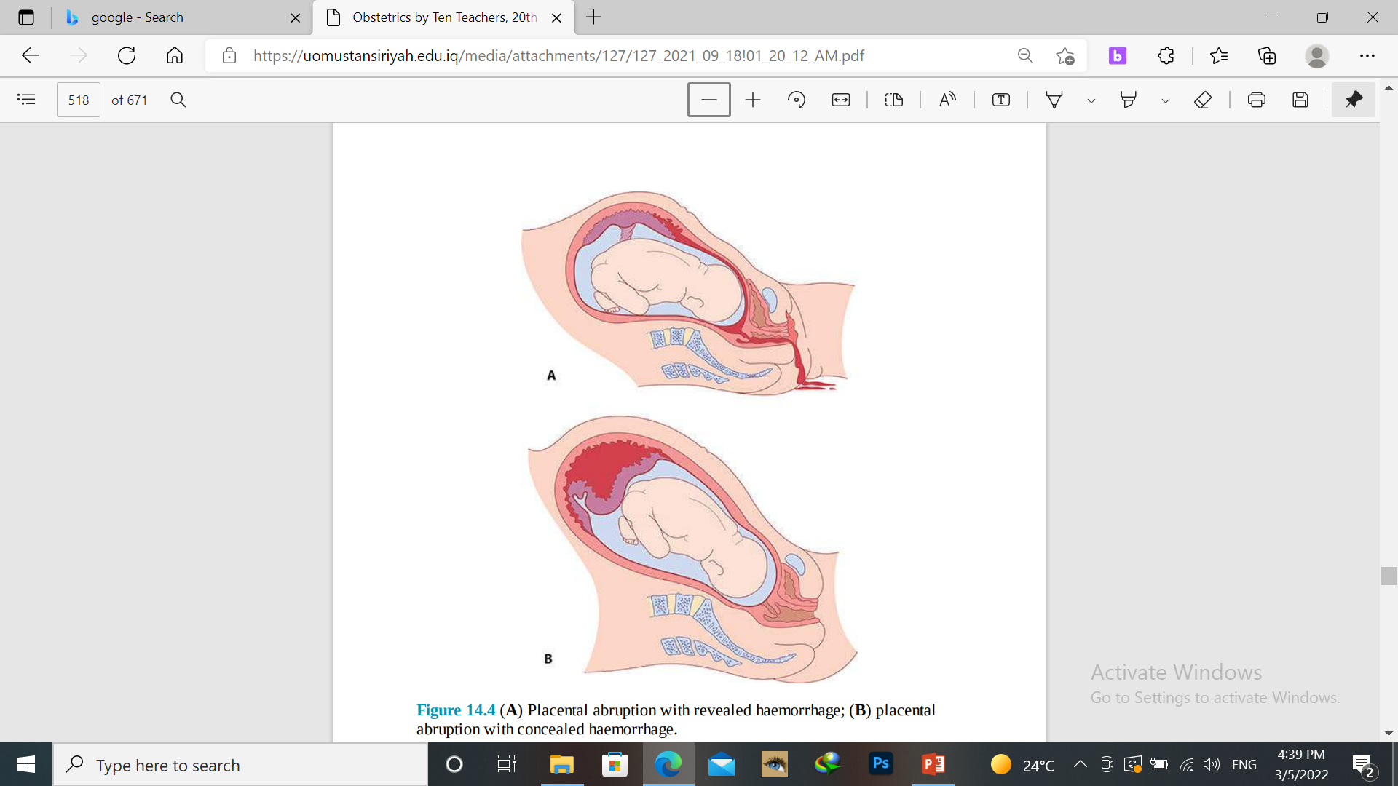
Bleeding which is clinically obvious is
revealed hemorrhage
Much of the bleeding that occur from an abruption is not discharged through the vagina and is known as concealed hemorrhage .
most times it is obviously
mixed

Slide 7
Risk factors
University of Basrah
Al-Zahraa Medical College
Ministry of higher Education and Scientific Research
Hypertension (including preeclampsia),
Smoking .
Trauma to the maternal abdomen .
Cocaine/smoking .
Polyhydramnios .
Multiple pregnancy .
Fetal growth restriction (FGR).
pPROM .
Multiparity .

Slide 8
Clinical presentations
University of Basrah
Al-Zahraa Medical College
Ministry of higher Education and Scientific Research
vaginal bleeding .
abdominal pain .
sweating, shock, hypotension, tachycardia .
absence or reduced fetal movements and tense painful abdomen. CTG may reveal evidence of fetal distress .
The degree of vaginal bleeding does not necessarily correlate with the degree of abruption as abruptions may be concealed .

Slide 9
University of Basrah
Al-Zahraa Medical College
Ministry of higher Education and Scientific Research
Investigations :
The diagnosis is mainly clinical.
Depending on the degree of bleeding, full blood count, clotting and, if suspected praevia/abruption, cross-match 6 units of blood.
Ultrasound (fetal size, presentation, amniotic fluid, placental position and morphology).
Treatment:
resuscitation and stabilization of mother
Then according to the gestational age and status of the fetus and the type of abruption

Slide 10
University of Basrah
Al-Zahraa Medical College
Ministry of higher Education and Scientific Research
Placenta praevia
A placenta is abnormally situated in the lower uterine segment and may cover the cervical os . The bleeding is from the maternal not fetal circulation and is more likely to compromise the mother than the fetus .
Risk factors:
multiple gestation .
previous caesarean section.
uterine structural anomaly.
assisted conception.
Previous uterine operations like myomectomy/D&C .
Multiparity .
Smoking .

Slide 11
Grades of placenta previa
University of Basrah
Al-Zahraa Medical College
Ministry of higher Education and Scientific Research
Grade I The placenta reaches the lower segment but not the internal os . ( almost 2,5 – 3 cm away from the internal os )
Grade II the placenta reach the internal os but dose not cover it .
Grade III the placenta partially covers the internal os .
Grade IV the placenta completely covers the internal os of the cervix .

Slide 12
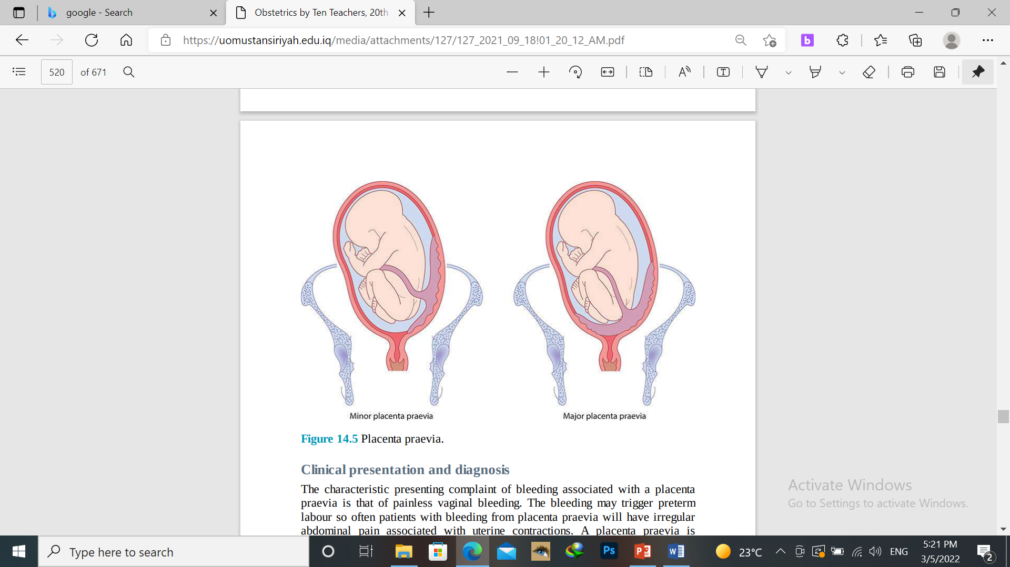

Slide 13
University of Basrah
Al-Zahraa Medical College
Ministry of higher Education and Scientific Research
There is a risk that the placenta implant into , And thus invades into the previous scar. This is called a MORBID adherent placenta, and there are three types
1- Placenta accreta .Placenta is abnormally adherent to the lower uterine wall There is no decidua basalis, & the fibrinnoid layer is incompletly developed
2- Placenta increta Placenta is abnormally invading into the uterine wall ( myometrium )
3- Placenta Perecreta . The placenta penetrates the myometrium & may invade nearby viscera

Slide 14
Clinical presentation
University of Basrah
Al-Zahraa Medical College
Ministry of higher Education and Scientific Research
Painless vaginal bleeding
Recurrent vaginal bleeding
Good fetal movement
Soft abdomen/abnormal lie and presentation
Sever bleeding :signs of shock
DIAGNOSIS : - ultrasound
MANAGEMENT : \
according to
gestational age
Severity of bleeding
Type of previa

Slide 15
Asymptomatic low-lying placenta
University of Basrah
Al-Zahraa Medical College
Ministry of higher Education and Scientific Research
1)about 5% of pregnant women well have a low-lying placenta when scanned at 16-20 weeks of gestation.
2)The incidence of placenta previa at delivery is about 0.5% therefor in 9 out of 10 women the placenta will rise away from the cervix as the uterus grows
3)All women with a low lying placenta diagnosed in early pregnancy should be rescanned at 34 weeks’ gestation
4) advice the pregnant woman to avoid stressful work
5) Keep the woman Hb level above 10.5 g/L

Slide 16
University of Basrah
Al-Zahraa Medical College
Ministry of higher Education and Scientific Research
Placenta previa with bleeding .
1)admit to hospital .
2)insert a broad – bore I.V cannula and start an infusion with crystalloid solution in order to correct volume deficient .
3)Take blood for cross matching and hemoglobin estimation
4) packed RBC should be given if sever anemia is evident or there is continous uterine bleeding .
5) 6 units of PRBC should be crossed & held nearby. )
The urine out put should be maintained above 30 ml/h
6) Give anti D immunoglobline for Rh –ve patient .

Slide 17
University of Basrah
Al-Zahraa Medical College
Ministry of higher Education and Scientific Research
Vasa praevia
Vasa previa occurs when fetal vessels traverse the fetal membranes over the internal cervical os.
These vessels may be from either a velamentous insertion of the umbilical cord or may be joining an accessory (succenturiate) placental lobe to the main disc of the placenta.
The diagnosis is usually suspected when either spontaneous or artificial rupture of the membranes is accompanied by painless fresh vaginal bleeding from rupture of the fetal vessels.
This condition is associated with a very high perinatal mortality from fetal exsanguination. If the baby is still alive, once the diagnosis is suspected the immediate course of action is delivery by emergency caesarean section.

Slide 18
MANEGMENT OF SHOCKED PATIENT
University of Basrah
Al-Zahraa Medical College
Ministry of higher Education and Scientific Research
1.Call for help
2.ABC PROTOCOOL:
a.oxygen by mask at 10-15 l/m
b.cannulation(14-gauge x2)
C.left lateral position
D. keep the woman warm
E.transfuse blood as soon as possible
F.until the blood is available ,infuse up to 3.5l of warmed crystalloid solutions
G.insert urinary foleys catheter.
H.assess the fetus\0

Slide 19
University of Basrah
Al-Zahraa Medical College
Ministry of higher Education and Scientific Research
Ms B is 39 weeks’ gestation in her second pregnancy. Her first pregnancy was a term delivery, delivered 11 months previously by caesarean section at 5 cm dilated due to failure to progress. Ms B was induced due to FGR and has been on oxytocin for 4 hours and has made good progress. She is now 5 cm dilated when she develops severe constant abdominal pain associated with moderate VB. The midwife looking after her labour records the fetal heart rate as 100 beats per minute and calls an emergency alert.
A What is the likely diagnosis?
B What risk factors does Ms B have for this complication?
C How would you manage this situation?

